Slide 1
CPSC 5200
Software Architecture and Design

Slide 2
It’s story time
The names have not been changed, because the actors know they’re guilty

Slide 3
The situation
An organically-grown monolith comprising
A tax calculation engine written in VB.NET and C#
A ”reporting” system, an 8-hour cube process
SOAP interfaces and an SDK
2+ billion tax rows, run rate of ~100 million / month (and growing)
100ms budget per document
A batch subsystem based on a CSV format
A UI written in jQuery and ASPX web forms
A Silverlight application used for managing geographical boundaries
A map tiler

Slide 4
The features
A tax document calculation engine
An address cleaner and geocoder
An online ”tax map”
Batch-as-import
Report-as-export
~400 methods across 10 SOAP endpoints

Slide 5
The tax request
An XML “tax document” is received (invoice or purchase order)
Might be tagged as New, Update, or Temporary
Each document has several lines
Each line may have an address or two or three
Buyer and seller information are included (usually)
The product or service as a “tax code”

Slide 6
Taxation
Taxes are based on
The product or service being taxed
The point of sale, the point of origin, and the point of delivery
The class of buyer and the class of seller
The time of sale (tax holidays, etc.)
The taxation “jurisdictions” in effect

Slide 7
Some numbers
There are / were about 11,000 jurisdictions in the US (alone)
There are / were about 8,000 ”tax codes”
Sometimes many ”tax rules” applied to the intersection
So… about 9,000,000,000 possible tax operations to
Locate
Process
Report upon
Keep up to date
Research and build implementations for

Slide 8
Some problems
Tax calculations are getting slower with each release
Tax rules are very hard to change (guess where they live)
There’s a requirement to calculate historical taxes
The API has to change, but can’t (IAuditService, IAuditService2)
Bugs and incorrect rules are rampant in the software
Deployment takes 13 hours and 12 engineers (cost in dollars?)
The tax authorities change rules all the time without warning

Slide 9
Some more problems
None of the original developers were engineers
Many hands have touched the code
Most developers are long gone
Can’t keep the developers we have
Skill set issues, and our backup team is off-shore
Some tests exist, but they don’t necessarily test the right thing
Oh yeah, the primary key for our big table is 32 bit signed

Slide 10
Archeological expedition – what we found
Some processing, address resolution, takes ~28ms each
The system has 8 address ”resolvers”
Some parts of the software talk to itself… using SOAP
The tax calculation engine was following the wrong process
Many tax rules were incorrect
Sales and marketing mis-estimated growth by a factor of 100
Customers knew the calc budget better than we did
...and they’d call us when we exceeded it

Slide 11
And, nobody wanted to kiss the frog
Many private APIs were no longer private
A single batch request could take an entire blade offline
There was one database, but 30+ downstream replicants
Microsoft-hatred was rampant and pervasive
The SDK was perpetually 4+ releases behind
The spaghetti code meant steps could be repeated
Comments had become useless

Slide 12
The approach
Send in the cavalry (literally)

Slide 13
So, four parallel workstreams
Reverse engineer the tax rules
Pull the few that were “in the database”
Identify the ones in the code
Document and validate the actual tax rule calculation process
This was a classic case of RTFM and ask the SME
Figure out what was happening with addresses
Figure out what a correct address was, and fast
Run the address resolution process sub-28ms each
Reduce the time to tile the map
This process took hours and hours and hours, and was producing bad data

Slide 14
What we came up with
A grand unified theory of tax calculation
A set of 18 tax rule patterns with parameters
A DSL to describe tax rules and an engine to run them
A highly distributed architecture
A completely different map tiling approach
A set of optimized service-local storage patterns

Slide 15
The tech we landed on
AWS EC2 instances running Windows Server
A set of python-based deployment scripts
100,000 lines of C# with 60,000 of them as test code (from 1.5MM)
A single REST “API” for calculation
ASP.NET WebAPI as the controller layer
RabbitMQ for time- and space-independence
A suite of code generators to build the communications protocol
Cassandra databases for most storage
Hadoop and friends for reporting, analysis, and returns processing

Slide 16
TNG architecture overview

Slide 17
Flows

Slide 18
Overall approach
TNG is a platform and application, no UX or clients
.NET implementation throughout stack
JSON interchange models / data transfer objects
Focus on small, single function services
Shared infrastructure models
Shared type system
JSON and REST at the edge

Slide 19
Services
Standalone implementation
Think deployed object – data and functionality bound
They know nothing about their environment
They know nothing about other services
Contract defined in service-specific assembly
Implementation and mock in another assembly
Rest of infrastructure is boilerplate generated code

Slide 20
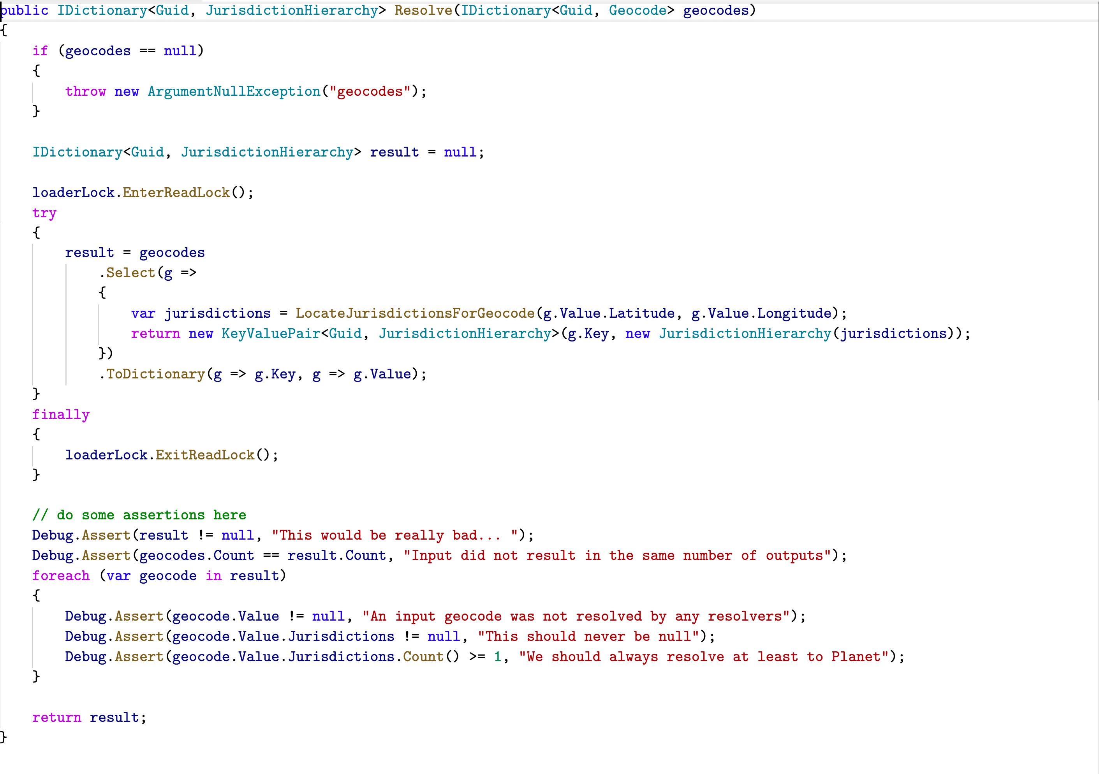
An example

Slide 21
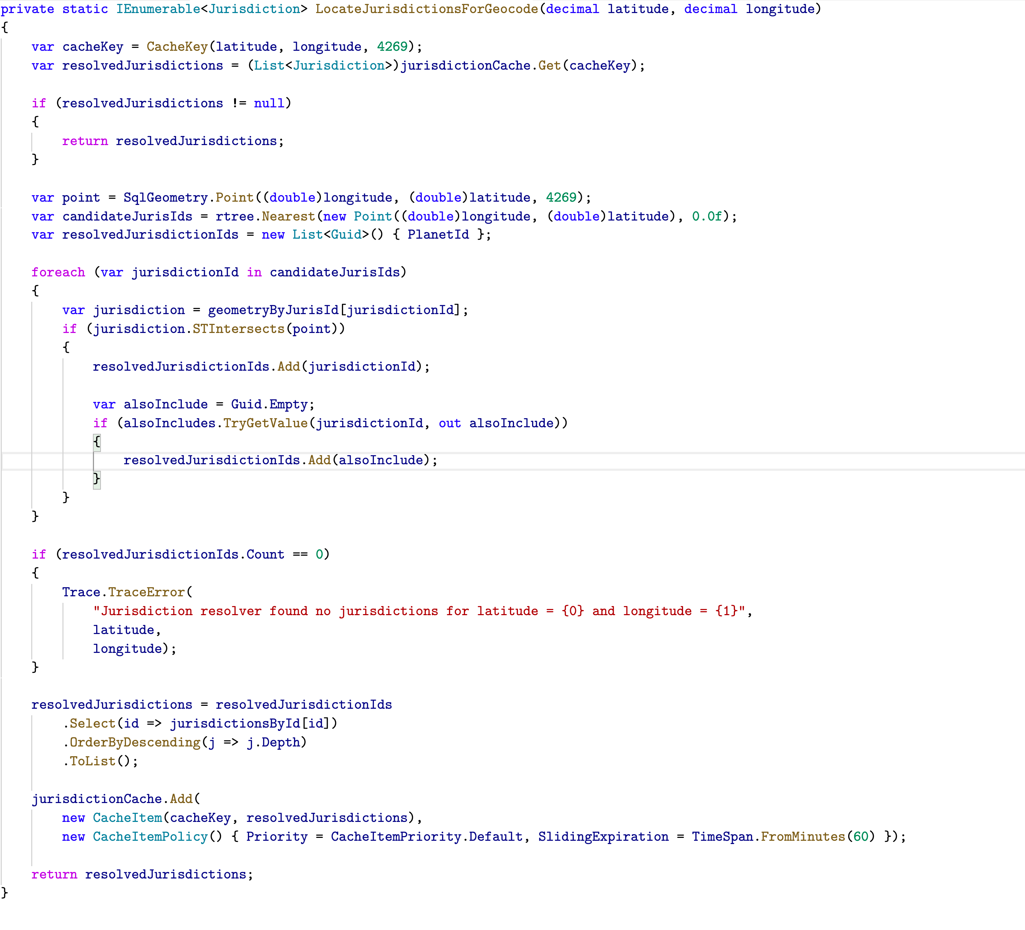
An example

Slide 22
Containers
Containers hold the implementation of a single service
Containers are specific to their environment
Containers are generated code
Examples
IIS behind JSON over REST (ASP.NET MVC API)
Azure worker role
Windows service
Windows application

Slide 23
Connectors
Connectors are generated code
Shared infrastructure components
Rabbit, Azure, and Amazon queues
IPC / in-proc
REST call
Provide a transparent communication path to services
Queues provide time and location independence
In-proc provides for simple small-scale deployment and testing
REST requires additional middleware components, e.g. F5

Slide 24
Application logic / workloads
Applications compose services to provide business value
Prototype application was C#
Application tier has own data model
Exposed via JSON and REST
We’re looking at switching to WF
Persistence of workload instances
Ability to automatically provide workload state

Slide 25
Configuration
Done using StructureMap Registries to handle IoC / DI
We will move to our own declarative model
Allows for configuration of
How the application tier locates a given service
How services locate underlying infrastructure components
How infrastructure configuration parameters are defined and used

Slide 26
Deployment / scale units
Performance requirements
Performance characteristics
Versioning and A/B tests
Latency
Data and cache locality
Different application and business models

Slide 27
Components
Component | Overview
Address normalizer | Wrapper over PostLocate and MelissaData, handles bulk normalization and geocoding
Calculator / tax rule applicator | Stateless and store-less tax calculator
Exemptions handler | Determines exemption applicability for a given request
Jurisdiction resolver | Locates jurisdiction lists based on geocodes
Product code normalizer | Converts external product code strings into internal product code types and handle application over customer overrides and custom codes
Sourcing rule resolver | Identifies the “source” rule for a given line item and request
Tax authority resolver | Identifies the tax authority for a given line item and request
Tax rule locator | Locates the collection of generally-applicable tax laws for a given set of geocodes

Slide 28
Infrastructure components
Component | Overview
Document store | Local store based on ESENT, used for testing only
Build system | Command line and VS-based MSBUILD, Dave is working on CI system
Connectors | Current connectors are hand-coded from template, Dave is building generator
Serialization | Dependency on JSON.NET with our custom serialization settings
Queues | Rabbit and SQS are implemented, Rabbit is running live in this demo
Tests | Currently 100 unit tests, run on each build
DI / IoC | Dependency on StructureMap,

Slide 29
Strangler

Slide 30
The architecture models

Slide 31
AI/C3

Slide 32
Customer portal

Slide 33
Applications

Slide 34
Returns processing

Slide 35
Content platform

Slide 36
Internal reporting

Slide 37
CP model

Slide 38
AI model

Slide 39
Batch processor

Slide 40
Full Monty

Slide 41
In the end
Address resolution across all 8 providers was ~2ms total
We hit our calc budget by a factor of 10x - ~12ms per document
We collapsed the message queues and used a different scale tech
We shipped a working prototype in 4 months
The project was production-ready in 12 months
Everybody quit and the project was killed

